Slide 1

MW-M31 Galaxy Major Merger Remnant: Stellar Disk Particle Distribution/Morphology
Marina M. Dunn
March 20, 2018

Slide 2
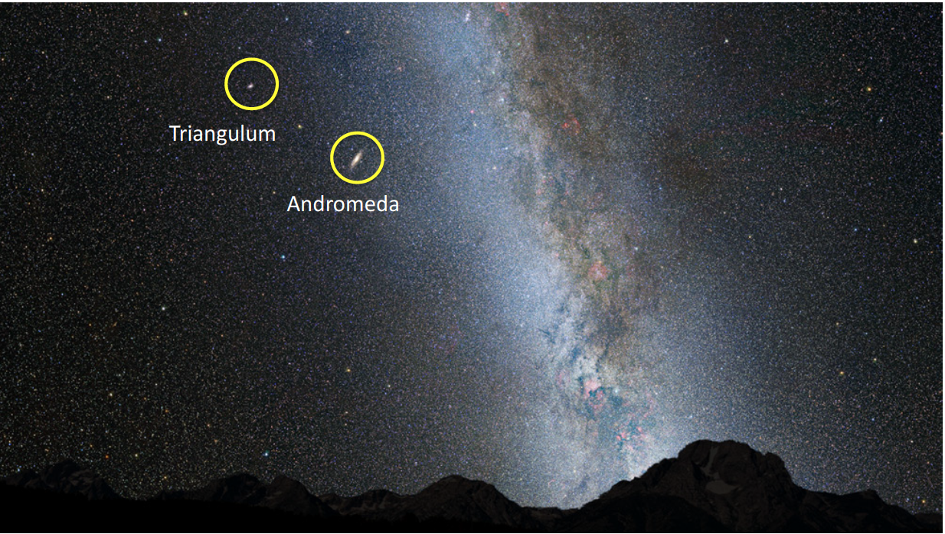
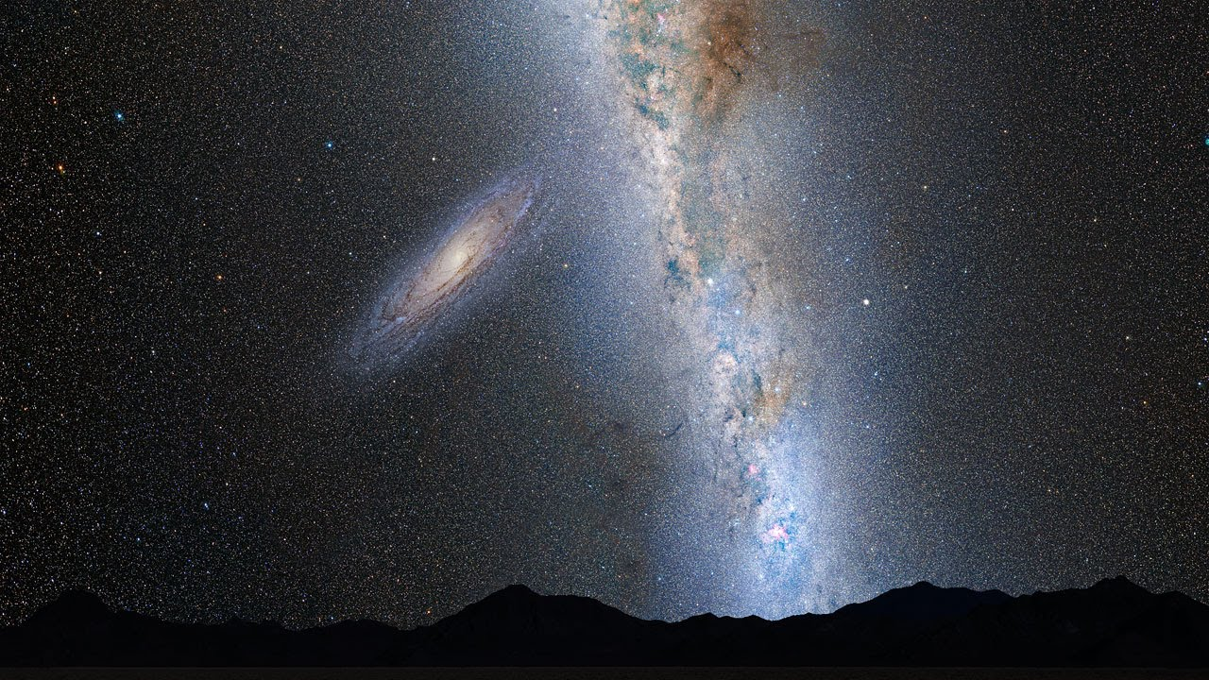
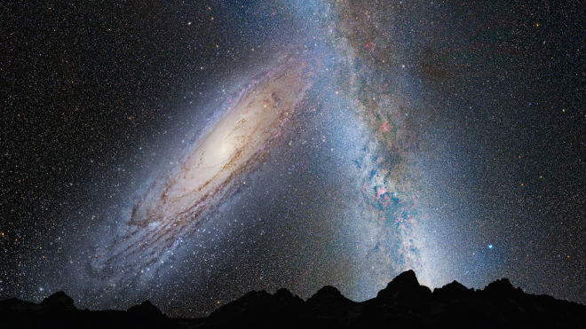
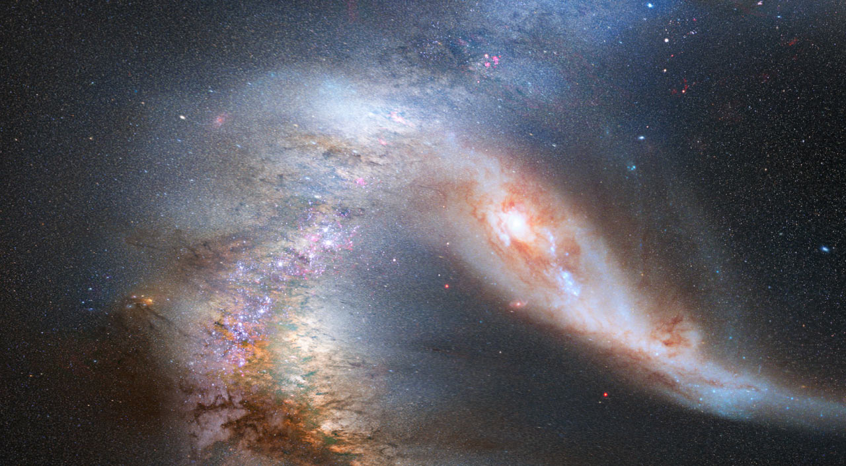
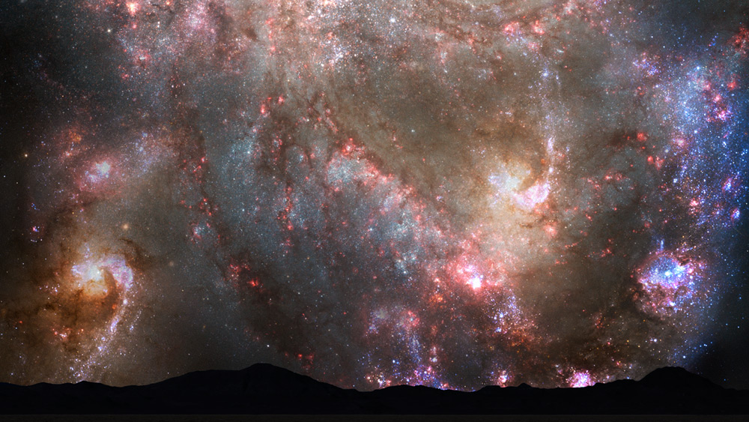

Slide 3
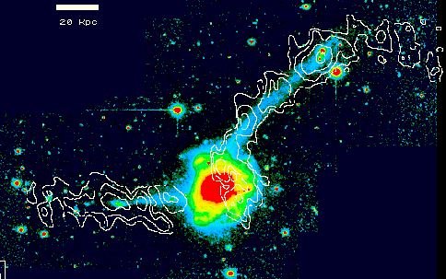
Merger Remnants Background
In 1977, Alar Toomre suggested merger remnants of disks could be responsible for a large population of ellipticals in the universe.
Observational evidence from Francois Schweizer of NGC 7572

Slide 4
Issues With Spiral --> Elliptical Theory
Frequency of globular clusters
High relative velocity of galaxies in clusters
Central phase-space density
So then how can disk galaxy mergers produce
so many present-day elliptical galaxies?

Slide 5
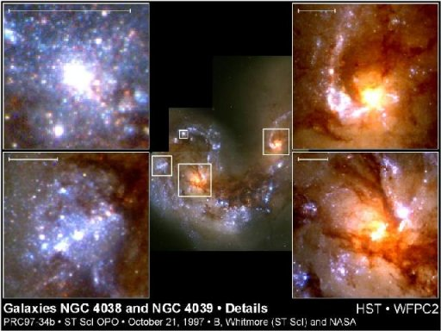
Recent Developments
Phase-space density doesn’t apply to gas
Interaction-induced star formation
Hierarchical structure to high relative velocity
Good News! It still works!
HST image of interacting galaxy pair NGC 4038/9 (The Antennae) (STScI)

Slide 6
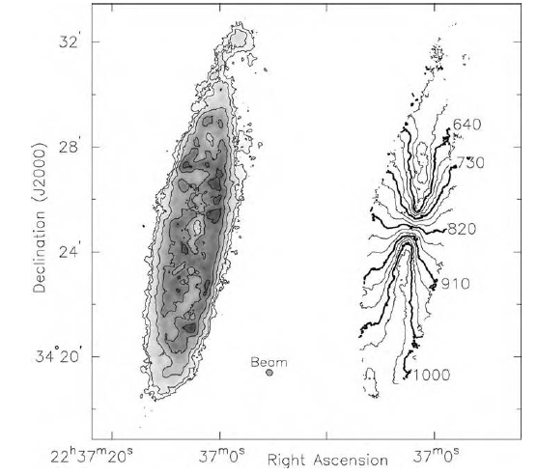
Review of Stellar Disk
Where most of the gas in spiral galaxy is contained (lots of cool HI & H₂)
For MW & M31, galactic center is more gas-poor, with HI concentrated in ring several kpc out
Gas spread out more uniformly than stellar light; peak density few times larger than avg. in ring
Fig 5.13 (A. Kinney) ‘Galaxies in the
Universe’ Sparke/Gallagher CUP 2007
Notes:
NGC 7331, from VLA, right: gas density

Slide 7
For This Project
Looking at Snapshot 0, will compare simulation data to observations in literature to see how the initial density/brightness profiles differ
Expect roughly the same results found in Homework 5 for disk mass (blue)

Slide 8
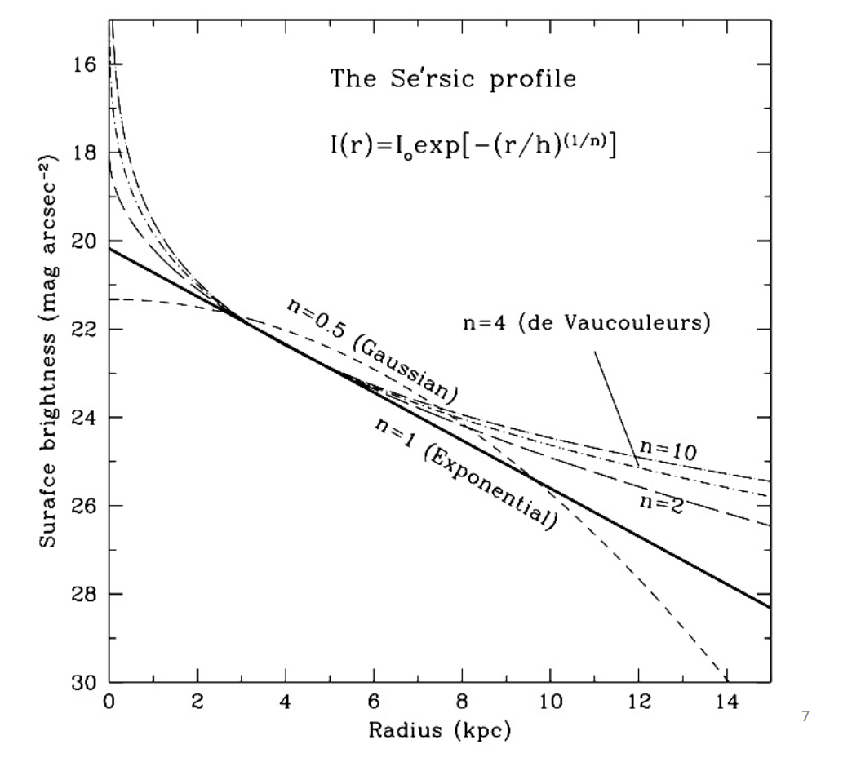
For This Project
Will plot enclosed mass vs. radius to find resulting mass profiles
Find the new brightness profile of remnant, and compare to expected result (Sersic index n=1 for exponential disks)
Lecture Handout 9

Slide 9
Why Is This Important?
(especially if we’re all going to be dead anyway)
It will help us answer several fundamental merger questions:
Does this merger remnant align with typical elliptical galaxy predictions?
How will star formation rates be affected?
Are the disk interactions insignificant compared to what will happen in halos?

